Slide 1
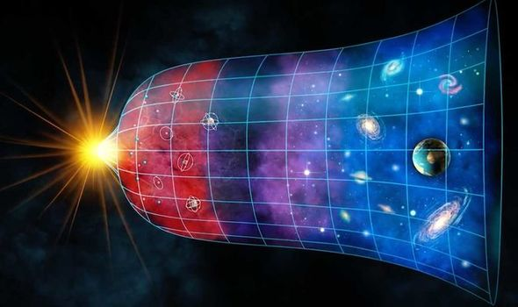
Teoría del Big Bang
Características del Universo
Expandiendo
Evolucionando
Entrópico
Teleológico
Teológico
Notes:
EXPANDING is the idea was initially founded on the observation by Edwin Hubble that distant galaxies were apparently moving away from us. It started as a singularity (very small point) and now is very big.
ENTROPY is the second law of thermodynamics. There is a natural gradual decline into disorder in all systems. Keeping any system ordered requires the investment of energy and effort.
EVOLVING describes the gradual development from simple to more complex forms. Think for example of the process of human development (Homo habilis, Homo floresiensis, Homo erectus, Homo sapiens).
TELEOLOGICAL means that it has purpose, moves towards a goal. In other words, it is intentionally ordered (order is imposed) and not the product of dumb luck and randomness.
THEOLOGICAL meaning that its existence, complexity, and beauty point to a higher intelligence, to a creator.
In its natural state, any system tends toward disorder rather than complexity (entropy). If you do not pickup your room, it does not have a tendency to get clean and orderly by itself. Quite the opposite. If you were to get to your dorm and all your clothes are washed, folded and put away, and everything was in its place, you would immediately know that someone must have done it. If I tell you that what happened was that you left the window open and the wind blew in and moved things around, you know that no amount of wind could randomly put order in your room. The clothes don’t just randomly go into the washing machine, and luckily the exact amount of detergent falls in at the exact time, and then by chance the right setting was selected … you say impossible. The probabilities of that happening are zero. When we observe the order in the universe (teleology) we logically sense a higher intelligence at work.

Slide 2
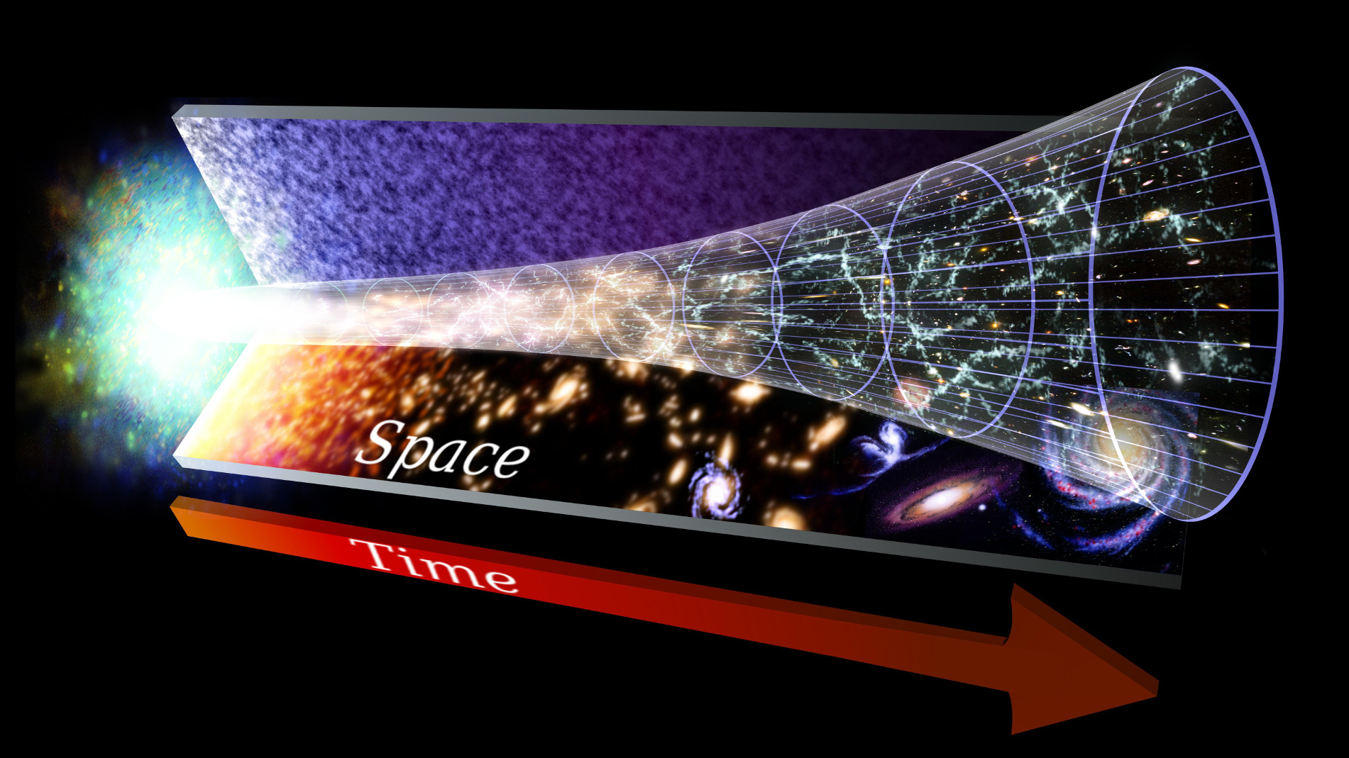
Expandiendo
Creciendo desde el Big Bang (13.7 Billones de Años)
Moviéndose en TODAS las Direcciones (No Hay Centro)
Galaxias se Alejan a Alta Velocidad

Slide 3
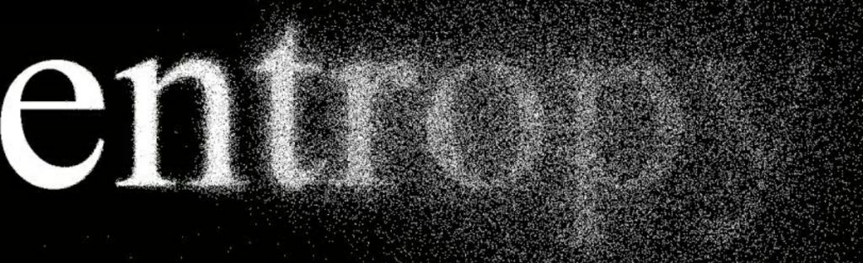
Entropía
Segunda Ley de Termodinámica
Decline Natural y Gradual al Desorden de los Sistemas
Mantener un Sistema Ordenado Requiere Energía y Esfuerzo

Slide 4
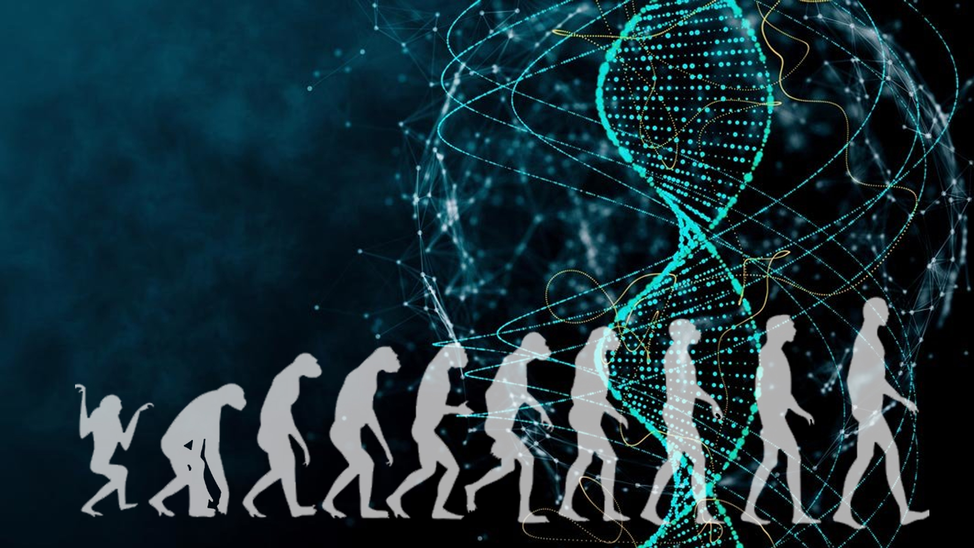
Evolucionando
Desarrollo Gradual
De Simple a Complejo
Se Dan las Condiciones de la Vida
Aparece el Género Homo
Aparece el Homo sapiens
Salto Ontológico con la Neocórtex

Slide 5
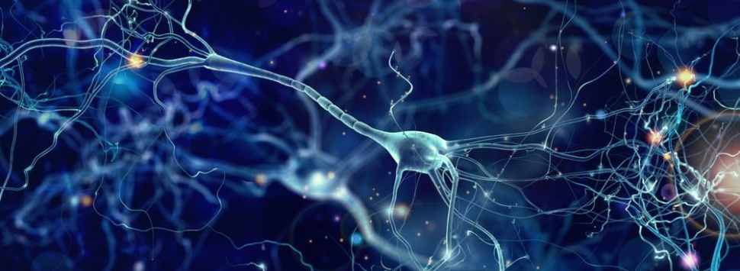
Teleológico
Tiene un Fin (Propósito)
Se Mueve Hacia ese Fin
Ordenado Intencionalmente (en contra de la entropía)
No Puede Ser el Resultado de la Suerte o el Azar

Slide 6
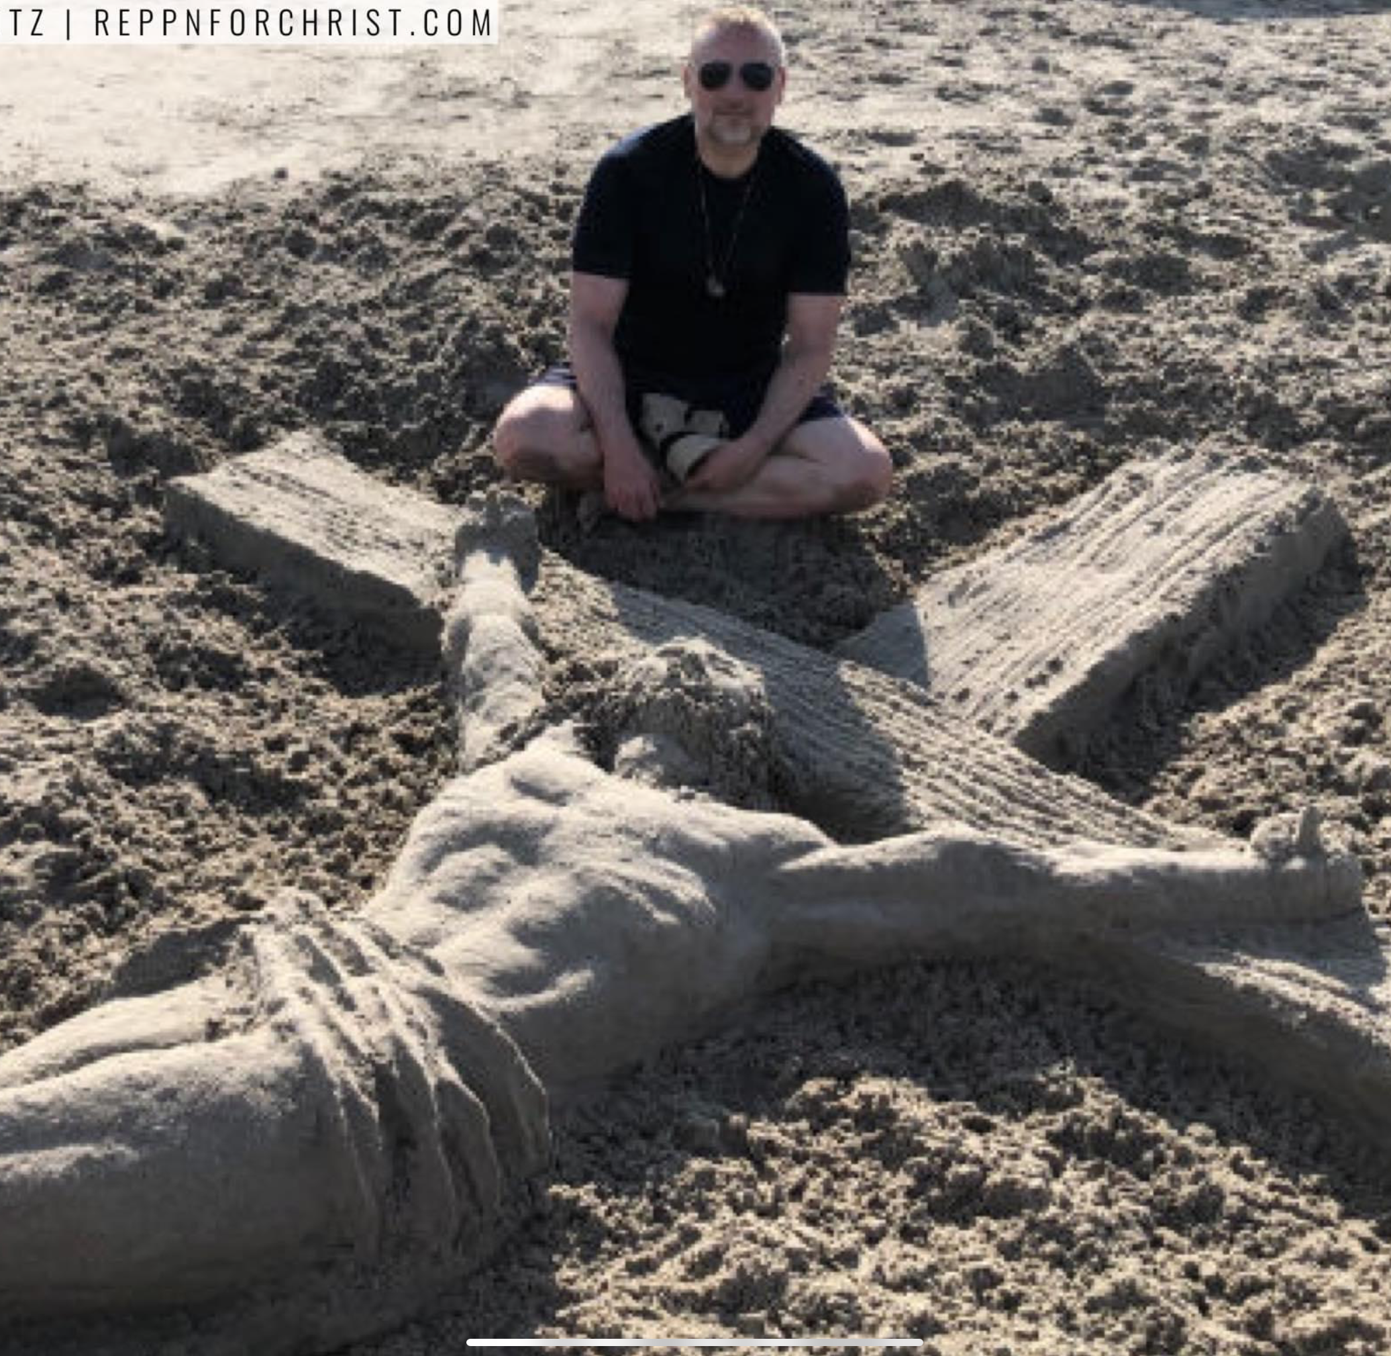
Requisitos
Inteligencia Artística
Maestría Artesanal - Talento
Voluntad, Intención, Esfuerzo
Determinación
Poder Creativo
… así será la palabra que salga de mi boca. No volverá a mí con las manos vacías sino después de haber hecho lo que yo quería,
y haber llevado a cabo lo que le encargué.
Isaía 55:11

Slide 7
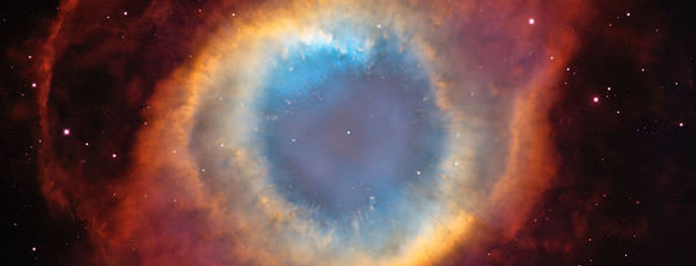

Al ver tu cielo, obra de tus dedos, la luna y las estrellas que has fijado…
Nébula el Ojo de Dios
Universo Como Fuente de Inspiración
Salma 8: 4

Slide 8
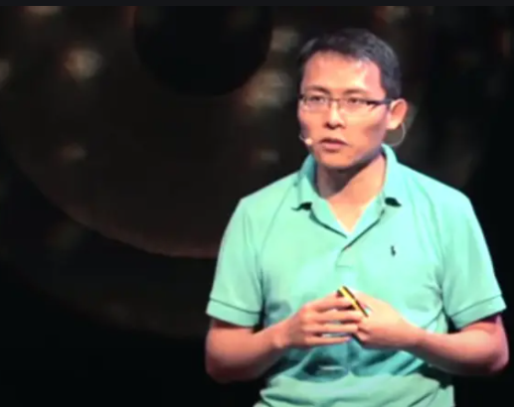
Tom Chi
Investigador de Astrofísica
El Mundo de la Personas
Microsoft Outlook
Yahoo Search
Google X
Automóbiles Autónomos deGoogle
Notes:
Tom Chi explains how he transferred from the world of astrophysics research to the world of people (Tom Chi has played a significant role in the development of global digital products and services including Microsoft Outlook and Yahoo Search. He served at head of product experience at Google X , contributing breakthrough technology to innovations like Google's autonomous vehicles). He claims that in the world of people, there remains a gap between us and the challenges that we face. What is the concept that this gap is related to?

Slide 9
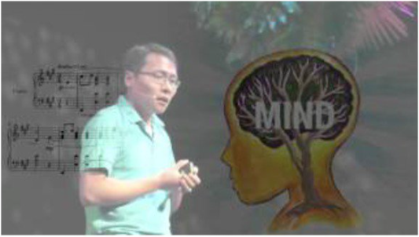
Tres Historias de Comunión
Historia del Corazón
La Historia de la Respiración
La Historia de la Mente

Slide 10
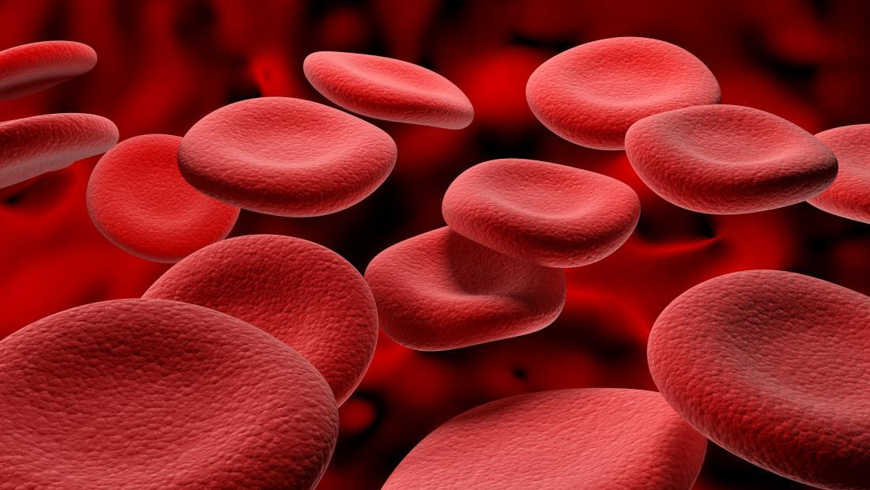
Historia del Corazón
La Molécula de Hemoglobina está constituida de grupos llamados Hemos
Al Centro de los Hemos Hay un Átomo de Hierro
El Hierro es lo que Permite la Fijación del Oxígeno en la Sangre
El Hierro se Forma Como Resultado de las Supernovas Cuando Chocan las Galaxias
Notes:
Hemoglobin molecules in our blood are made of four heme groups to which an iron atom is attached. The iron allows the binding of oxygen that the blood carries through our circulatory system. How is iron made? It is made by supernovas, the explosion of stars. Stars can form and explode as galaxies collide.
Hundreds of thousands of galaxies, swirling together, drive the process of galaxies colliding, which drives massive start formation, which drives the process of forming the iron that carries the oxygen that circulates through our arteries. This is how all of our heart beats are connected.

Slide 11
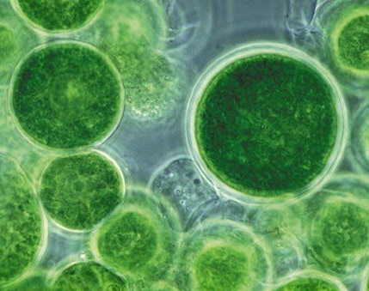
Historia del Respiro
Hace 3 Billiones de Años No Había Oxígeno en la Tierra
Había una Alta Acumulación de Monóxido de Carbono
Los Organismos Multi-Celulares No Podían Existir
Cianobacterias son Organismos Microscópicos de Células Simples
Realizan Fotosíntesis Generando Oxígeno
Crearon la Capa de Ozono
Relación Simbiótica con las Plantas
Notes:
Deep breaths are a way of connecting with out body. Yet taking deep breaths was not possible on this earth 3 billion years ago. At that time, there was no oxygen on our planet. Instead, there was a high accumulation of carbon dioxide, which made the life of complex multi-cellular organisms unsustainable. However, there were single-cell organism like cyanobacteria that were capable of generating oxygen through photosynthesis (taking energy from the sun and converting carbon dioxide into oxygen). Through a very slow process that took millions of years, cyanobacteria eventually created the ozone layer making our planet capable of sustaining life as we know it today.
Our breaths are deeply united. Every outbreath is mirrored by the inbreath of plants (cyanobacteria were capture by plants and became chloroplast) and vice versa. We are connected in the oxygen we breathe.

Slide 12
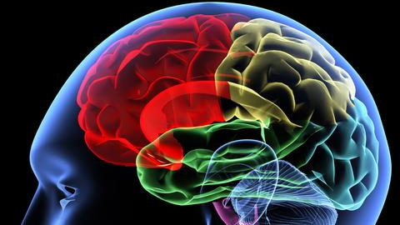
Historia de la Mente
Se Requiere una Estructura Cerebral para Poder Tocar el Piano
El Piano no Existía hace 200 Años
Desarrollo Gradual
La Paleta Ontológica
Sólo Podemos Pintar con las Estructuras Disponibles
Notes:
Tom Chi explains the connection of the mind through a story about the piano. He points out that playing this instrument requires a substantial number of connections in the brain. Yet, these brain connections did not exist 200 years ago before the invention of the piano. Even the possibility of inventing this magnificent string instrument required the gradual development of brain structures capable of producing something like it. He calls this concept the palette of being. What does he mean by the palette of being?
We are born into this life having available to us the experiences of humanity that have come thus far. Typically, we are only able to "paint" with the brain structures (patterns of thought) and the ways of being that existed before. Two hundred years ago the piano and computer science were not available in our "palate."

Slide 13
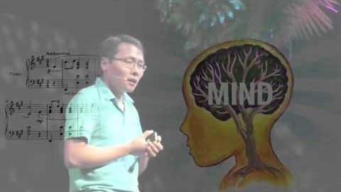
Notes:
Begin at 14:13

Slide 14

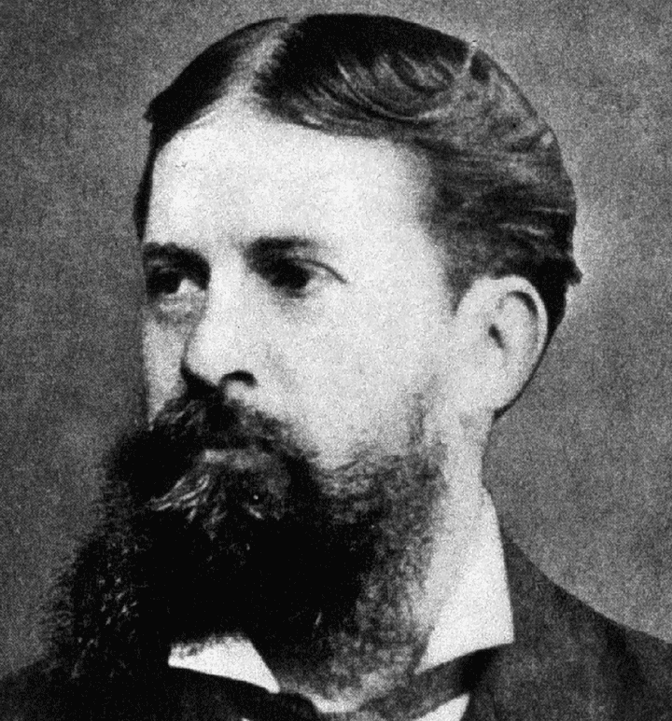
Charles Sanders Peirce (1839-1914)
Padre del Pragmatismo Americano
Científico
Filósofo
Padre de la Semiótica Contemporánea
Lógica

Slide 15
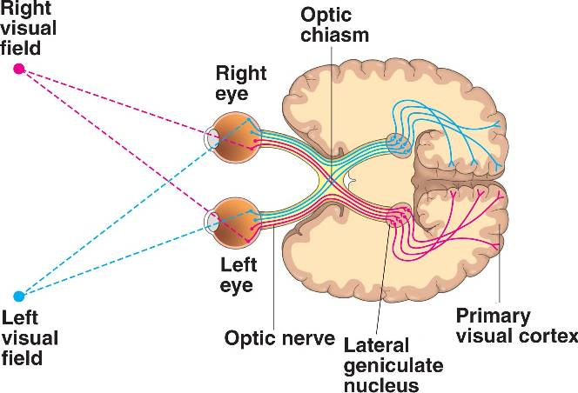
La Percepción de la Realidad
El Sistema Visual
Retina (Conos y Bastones)
Nervio Óptico
Núcleo Geniculado Lateral
Corteza Visual
Fototransducción

Slide 16
Procesamiento Visual: Representación
Campo Visual
Células Responden a un Estímulo
Se Crea una Representación

Slide 17
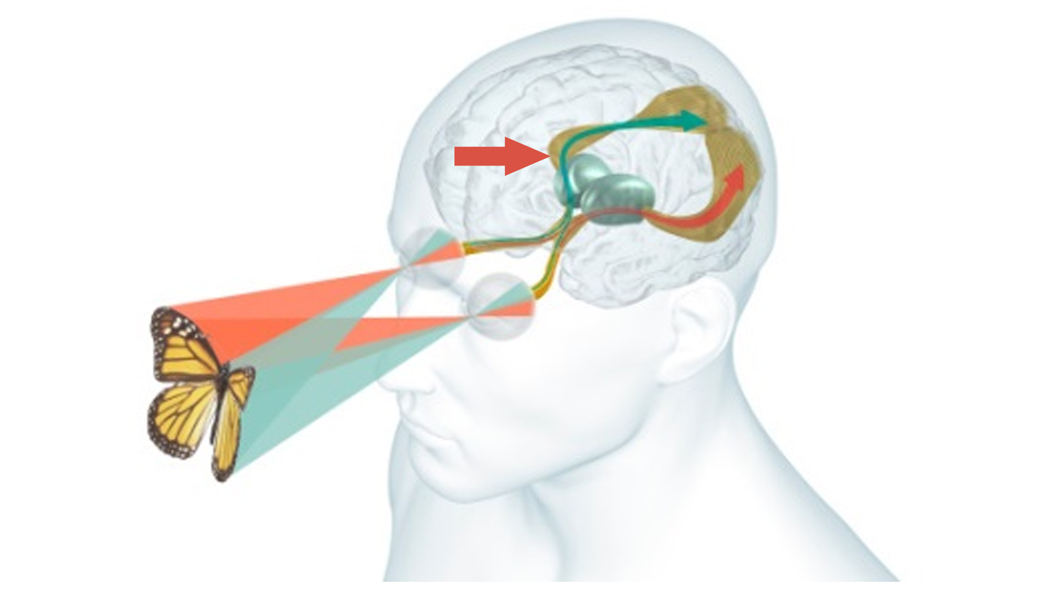
1. Realidad (Objeto)
3. Interpretación de la Percepción
2. Representación de la Percepción Visual

Slide 18

Ilusiones Ópticas
La Realidad Representada en el Cerebro

Slide 19

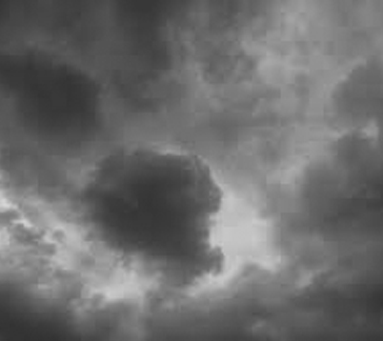

Semiótica
Ciencia que Estudia los Signos
Definición de un Signo: Cualquier Cosa que Produzca un Significado
Tipos de Signos
Ícono (Representación)
Índice (Indicador Natural)
Símbolo (Convencional)

Slide 20
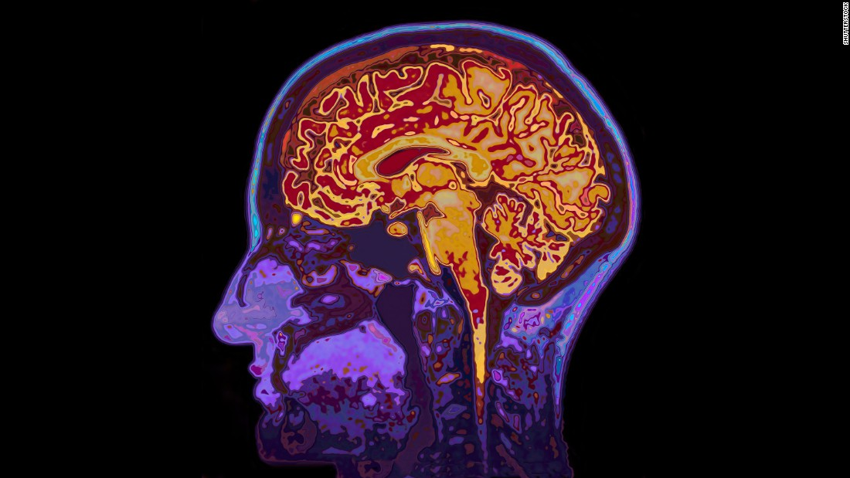
Semiosis
Objecto
Signo (Representamen)
Efecto (Interpretante)
Un SIGNO representa un OBJECTO y produce un EFECTO en la mente de otra persona

Slide 21
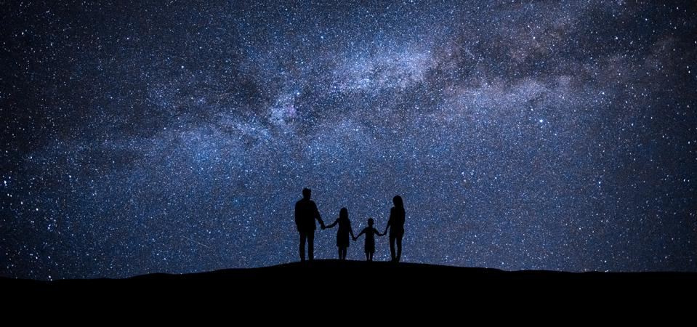
La Experiencia Común es Condición Necesaria para la Semiosis

Slide 22
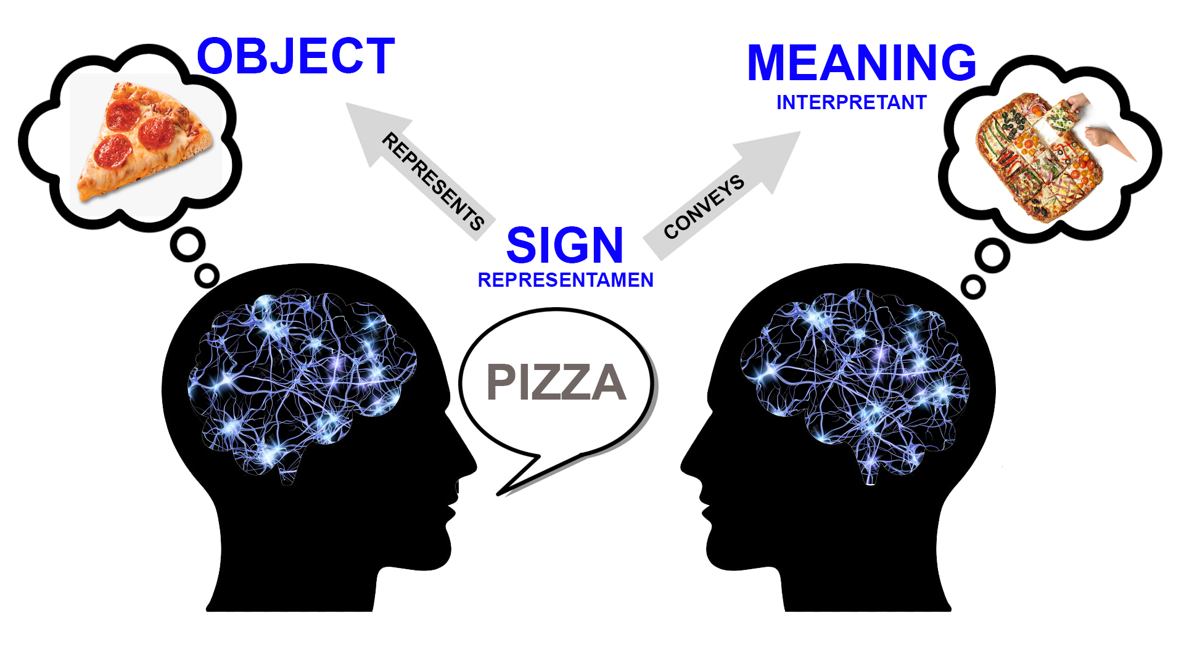
Semiosis
OBJETO
EFECTO
SIGNO

Slide 23

Construcción Social de la Realidad
Sociólogo Peter Berger
Existencia Material y Existencia Real
El Papel de la Semiótica
Universales (Nominalismo vs. Realismo)
Notes:
El Dosel Sagrado: Para Una Teoría Sociológica De La Religión
by Peter L. Berger

